Slide 1
The neighborhoods in LA
Lin Cheng

Slide 2
Introduction/Problems
This project will serve as a guidance for people to
find the neighborhoods of their best fit.
Conveniency and crime rate around a neighborhood will be the priority when making such decisions.
This project will be done with the use of k-clustering.
The project will answer the questions
Which area is most crowded with the most venues nearby?
What crime happens most frequently in that area?

Slide 3
Data
Crime in Los Angeles
Link: https://www.kaggle.com/cityofLA/crime-in-los-angeles We will observe the crime rate in each area.
Zip Code of Neighborhoods in LA
Link: http://www.laalmanac.com/communications/cm02_communities.php Extract the zip code of each area from this data set
ArcGIS API
Foursquare API

Slide 4
Methodology
The methodology can be grouped by three parts:
Data Importing and Data Cleaning (for all 4 data sources listed in the data section)
Model Building
Cluster Examination

Slide 5
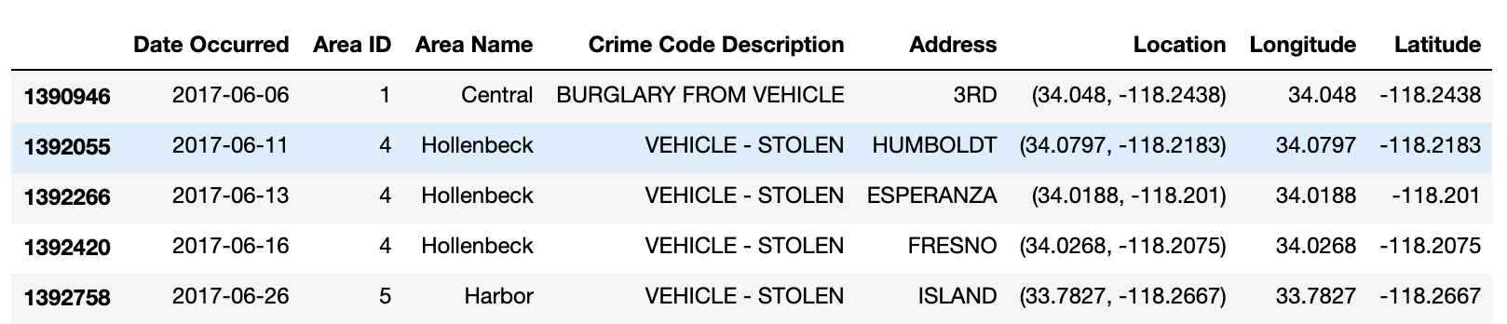
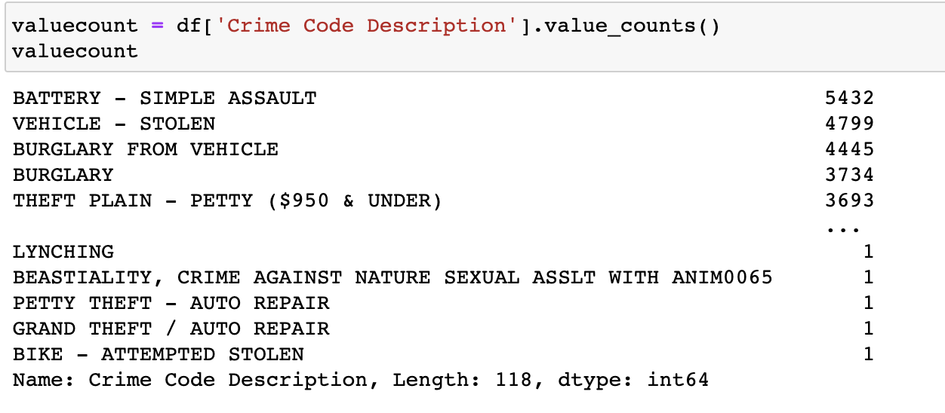
Data Importing and Data Cleaning
1. Crime Data
Table 1
Table 2

Slide 6
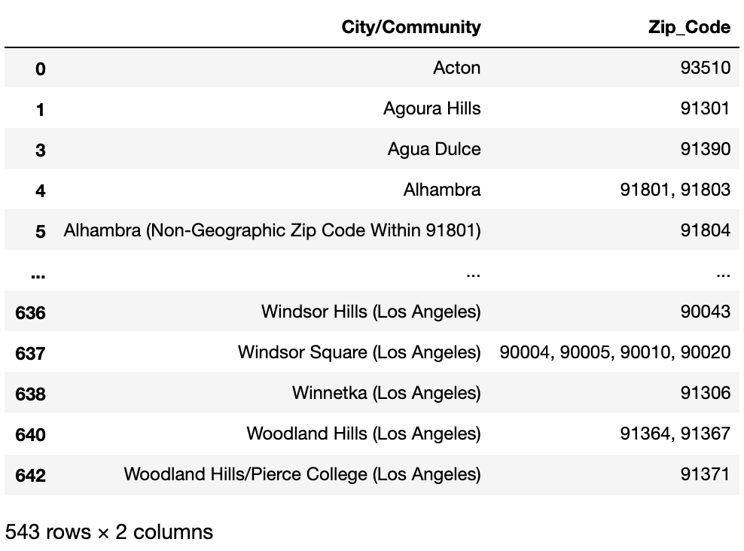
2. Zip Code of Neighborhoods in LA
Table 3

Slide 7
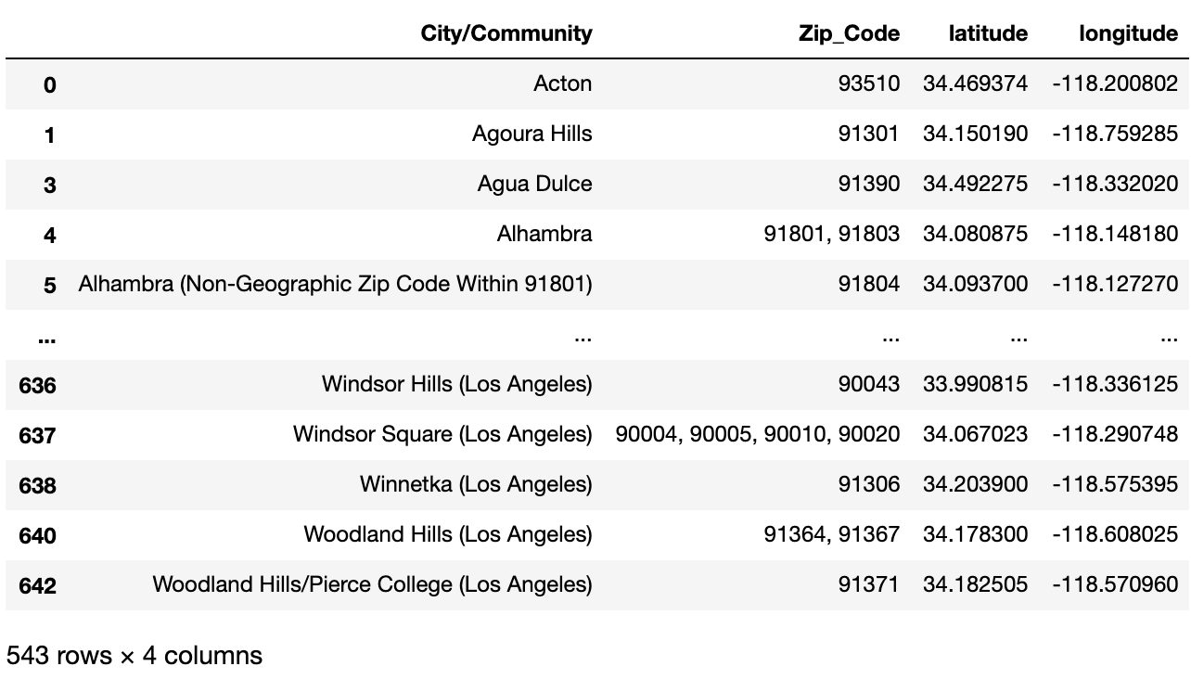
3. ArcGIS API
We joined the latitude and longitude (generated by ArcGIS API to table 3 in previous page.
Table 4

Slide 8
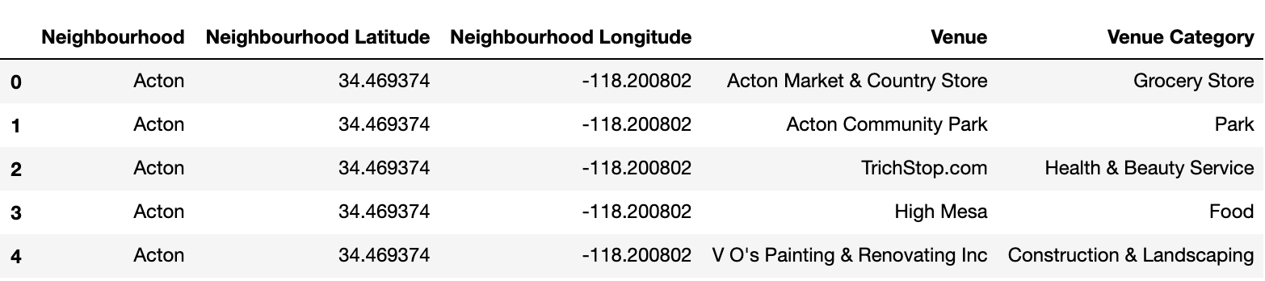
4. Foursquare API
We pass table 4 in previous page through the function ‘getNearbyVenues’ using Foursquare API to get table 5 shown below.
Table 5

Slide 9
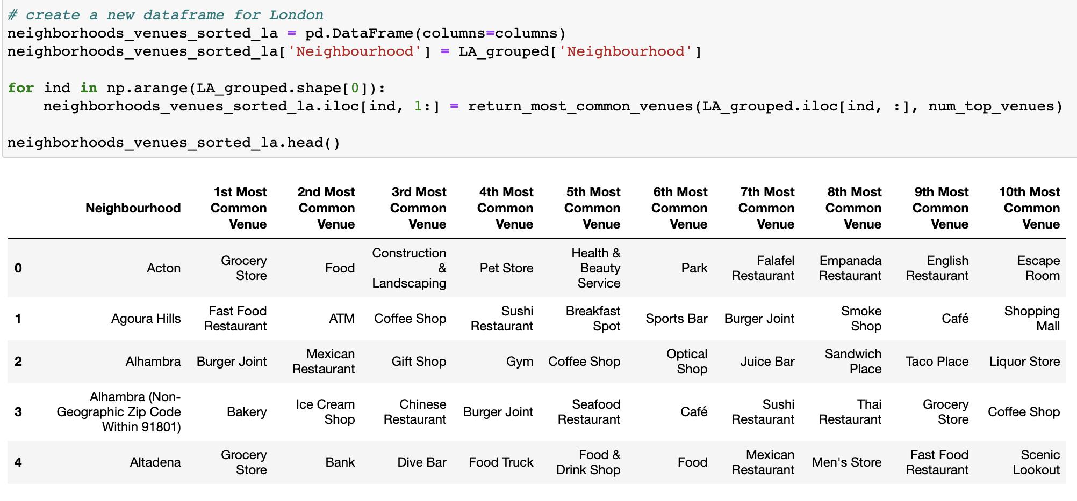
Cont.
Most Common Venues in each neighborhood
Table 6

Slide 10
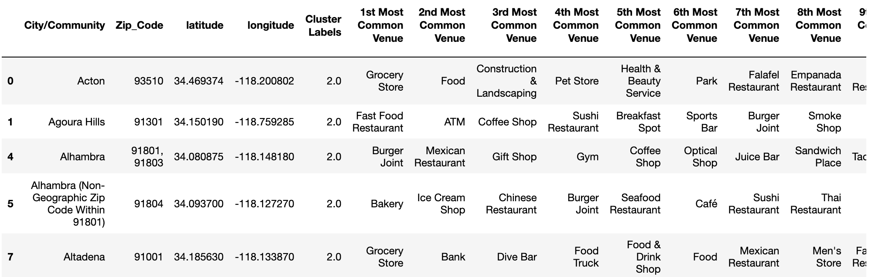
Model Building
1. Cluster the city of LA to 5.
2. Run k-means clustering.
3. Label Clustered Data.
4. Join the table to la_merged on 'City/Community'/
5. Drop the NaN’s.
Then we get a table that looks like this.
Table 7

Slide 11
Cluster Examination
We separated the date sets into five different clusters k-means cluster algorithm.

Slide 12
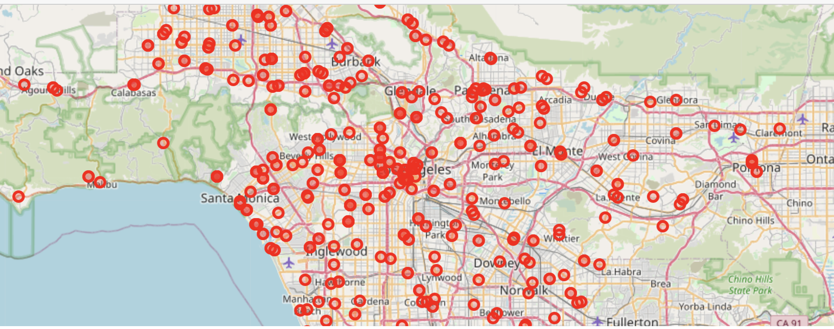
Result
Map of Los Angeles, CA

Slide 13
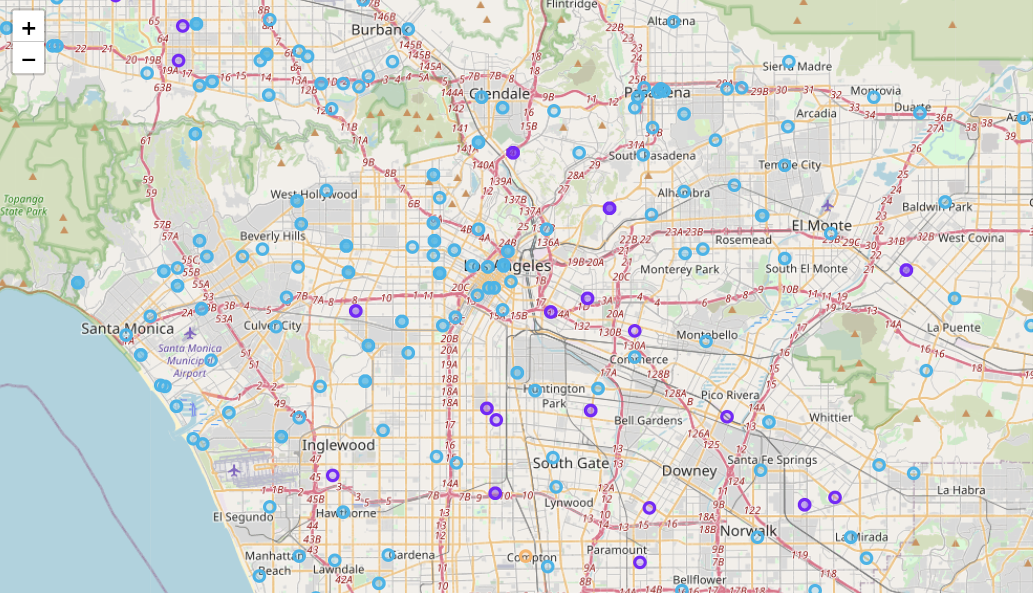
Cluster Map

Slide 14
Discussion
Problem To find answer to the following questions:
Which area is most crowded with the most venues nearby?
The County of Los Angeles is most crowded around downtown LA and less crowded as we move away from the center towards West Covina, Norwalk, Monterey Park, etc., or even further to Thousand Oaks, likely sacraficing conveniency.
What crime happens most frequently in that area?
Battery - Simple Assult.

Slide 15
Conclusion
Los Angeles is a popular destination for new immigrants to the United States. It is one of the most diverse and multicultural areas in California.
There are a lot of different restaurants serving Chinese, Korean, Japanese, Italian, Thai food, etc. LA seems to take a step further in this direction by having a lot of bars, coffee shops, Breakfast spots, and sweets shop.
There are also lots of big shopping malls, Flea markets, flower shops, seafood markets, etc. The main modes of transport seem to be cars. Almost every family owns a car. Overall, the city of LA offers a multicultural, diverse and an entertaining experience.

Slide 16
Cont.
In this project, We first observed the type of crimes happening around the neighbourhoods in LA and got a sense of crime rate and the most common type of crime that happens there.
Then we extratced the zip codes of different city/community in LA and pass it through ArcGIS API to get the logitude and latitude corresponding to each zip code. From this, we are able to generate a map visualization of LA and see which areas are most crowded with various types of venues.
At last, using k-means cluster algorithm, we built a model to separate the neighborhood into five different clusters for 522 different city/community in the county of LA. We also generated a cluster map from the five clusters. The clusters made the analysis process easier.
This project allowed me to come up with a practical problem to resolve a real-life situation, and to utilize many helpful data science tools and functions in the process.

